Slide 1


CITS1003 Introduction to Cybersecurity [4] Introduction to Computer Networks
Dr David Glance

Slide 2
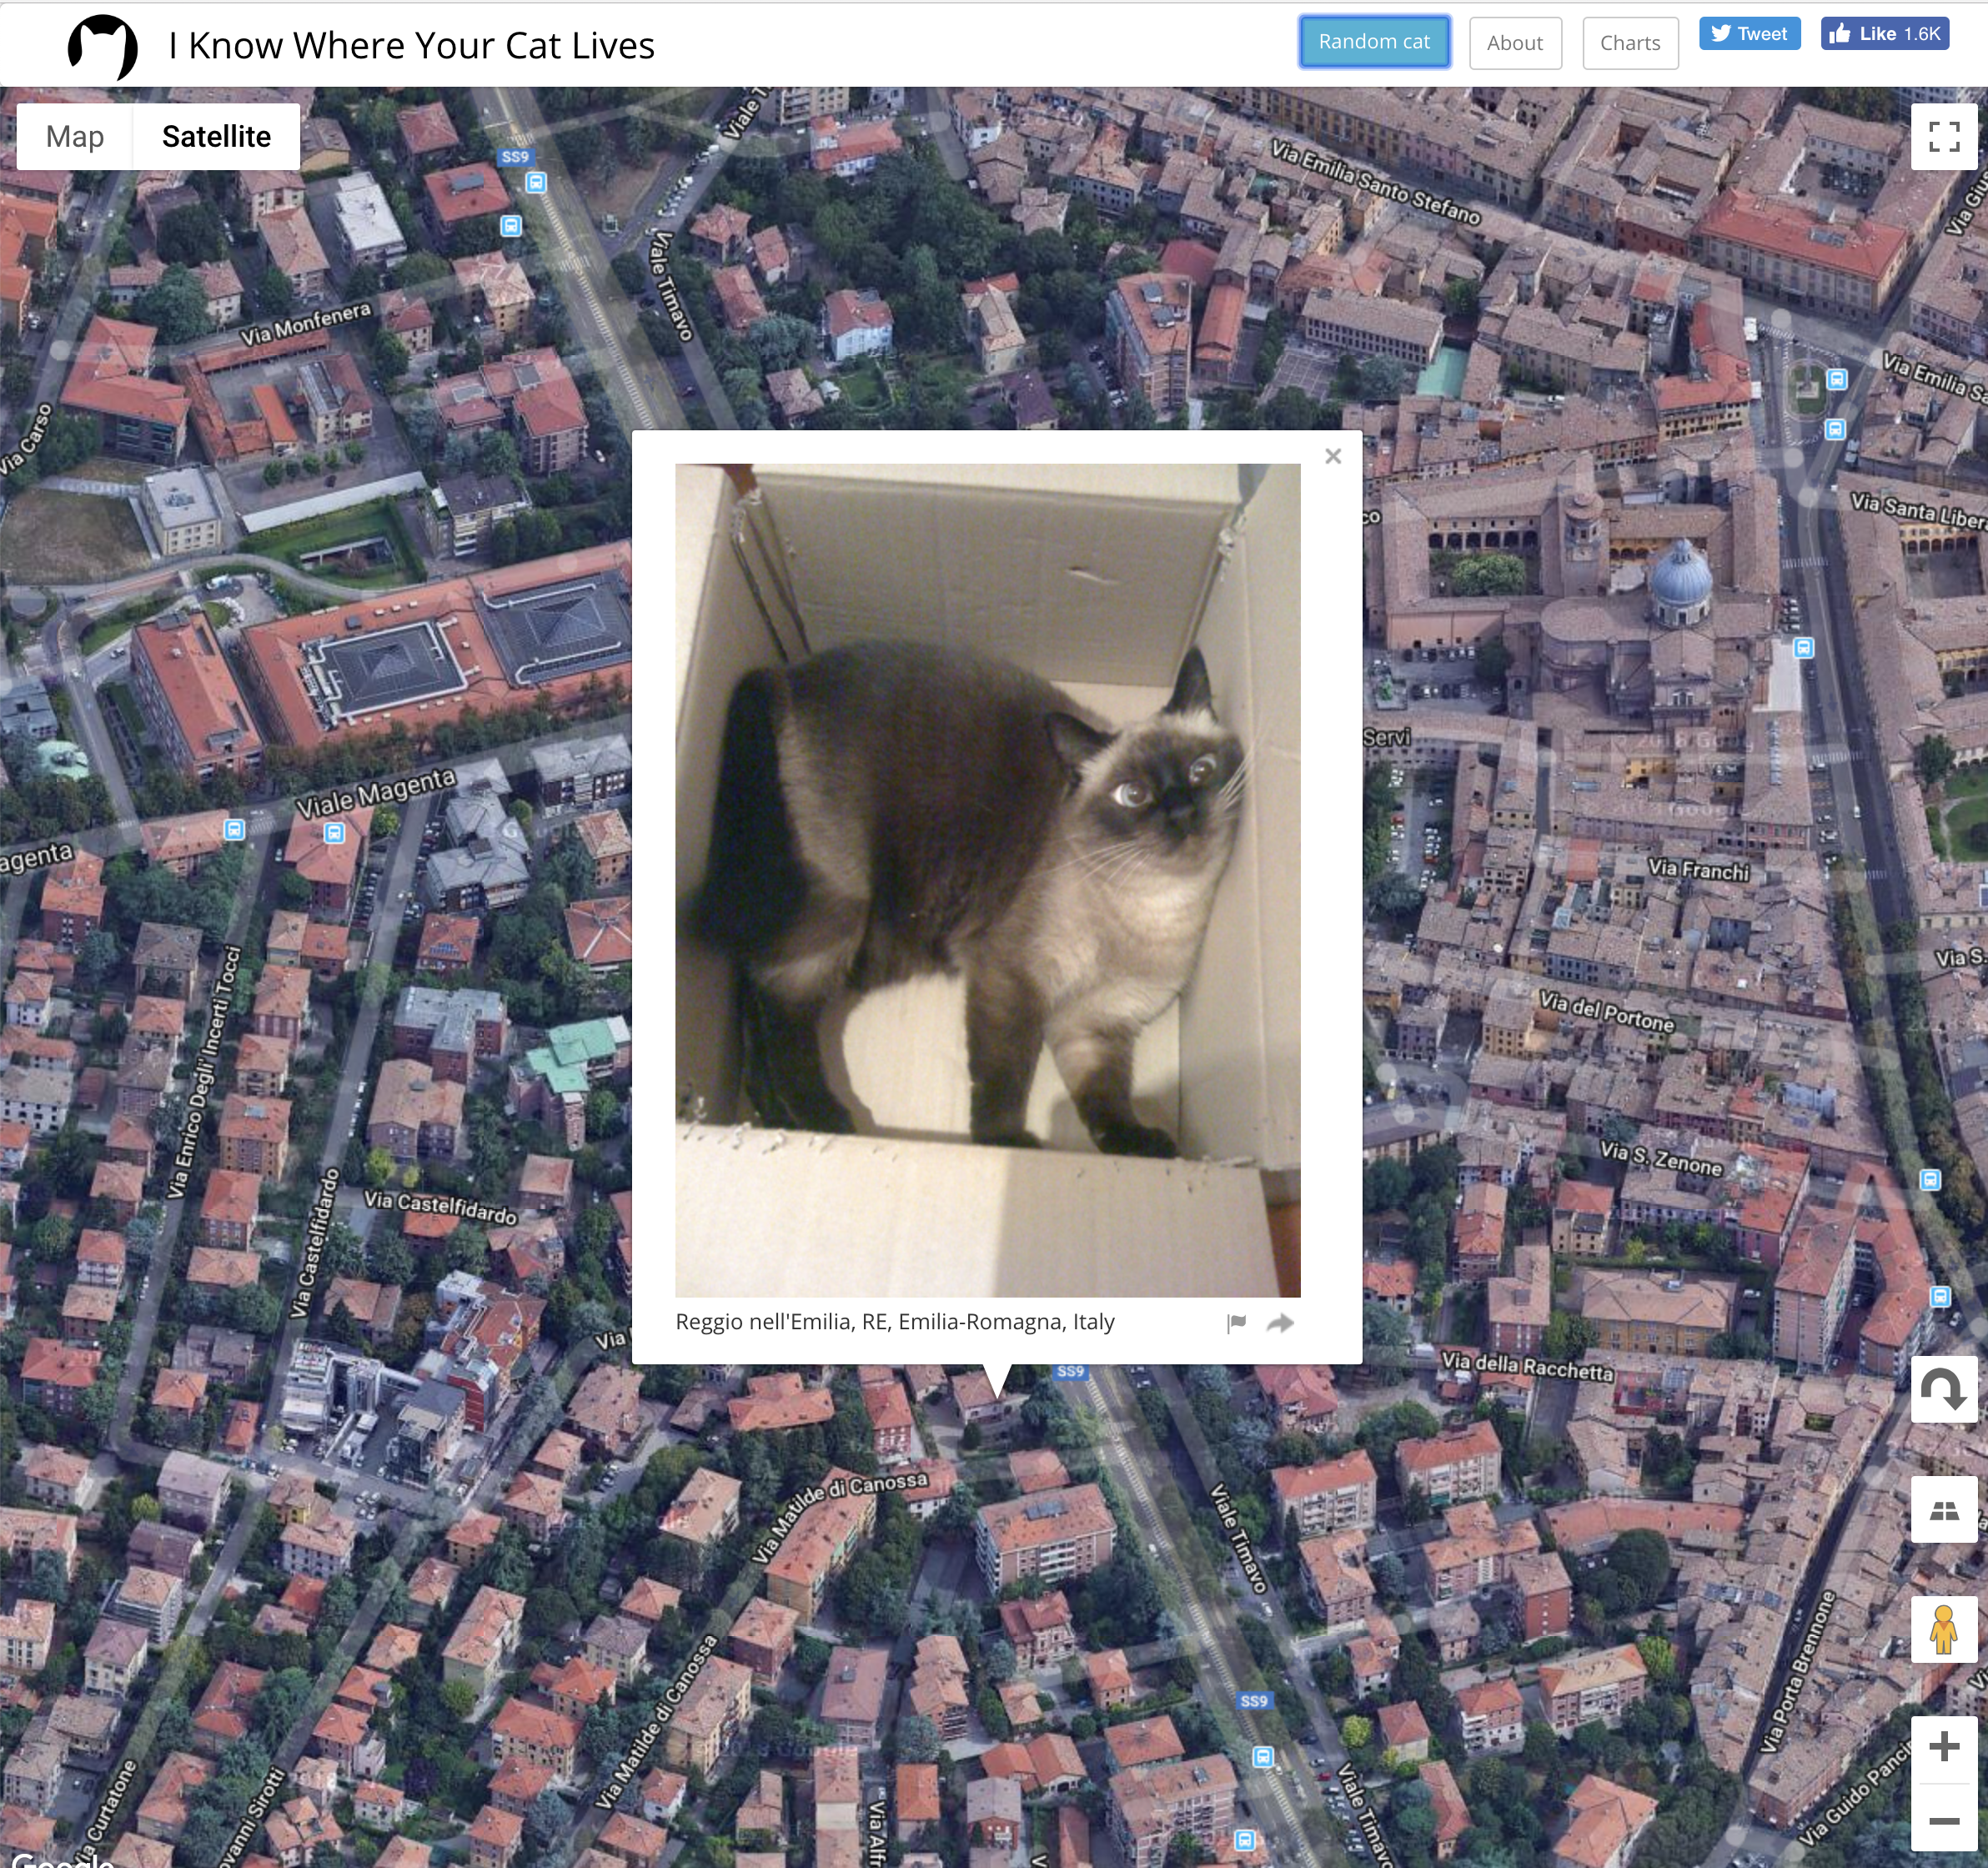
A unit about cats cybersecurity
I Know Where Your Cat Lives
https://iknowwhereyourcatlives.com/

Slide 3

Three things
Fundamentals and language of computer hardware and operating systems
How operating systems implement security
Fundamentals of networking and network security

Slide 4
Computers and Networks
Although we are focussed on general ideas around Cybersecurity, it is useful to at least have some understanding of computers and the networks they use to communicate over
We will look at PC architecture first in a generalised way and then the basics of how computer networks operate, especially TCP/IP, the network protocol of the Internet

Slide 5
Networking
A network card is responsible for the interface with either a fixed network or with WiFi
Both run TCP/IP which is a layered protocol
Each layer adds information to a packet in order for it to travel over the medium
The Link layer deals with the physical network
Each Network Interface Card (NIC) is assigned a unique number to identify it known as the MAC (Media Access Control) address
f8:ff:c2:01:fa:e5

Slide 6
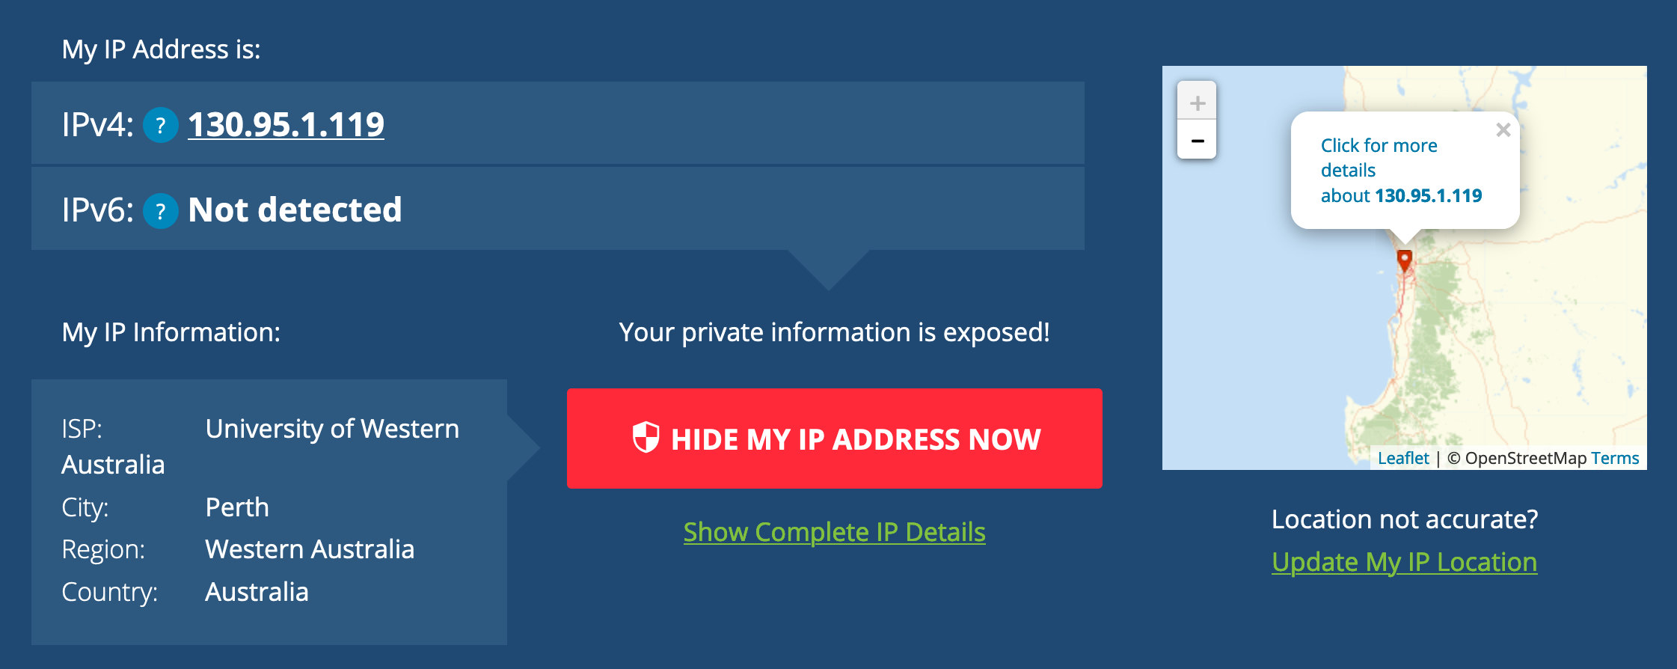
IP Addresses
In the Internet layer, TCP/IP uses IP addresses to identify the machine that is sending, and the machine that is going to receive the packet. The IP address is normally 4 numbers separated by full stops
130.95.1.119
To make it easier to find addresses, we can use a domain name
www.uwa.edu.au which translates to13.70.147.206
TCP/IP uses a Domain Name Server (DNS) as a directory to do the translation. The DNS is a service that internet service providers (ISPs) and organisations run to manage their own domain names
Technically, this is IP version 4. There is a newer version IP version 6 (IPv6) which uses a longer address format.

Slide 7
Network Addresses
An IP address is actually a combination of a network address and a host address.
Computers can directly communicate with each other on a subnetwork without going through a router.
A router connects subnetworks to other networks
Everything running in a home exists on a subnetwork that is connected to the Internet via a router (and a modem)
The network portion of the address is indicated by a notation as follows:
130.95.1.0/24
The last byte is the host address and so on this subnet, there can be 254 hosts that can be addressed on this subnet

Slide 8
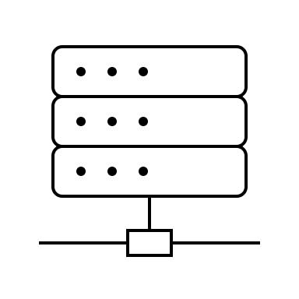
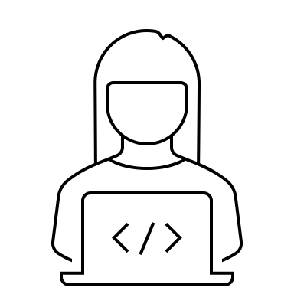
Application Ports
At the Application layer, TCP/IP decides which application to give a packet to based on an identifier called a port.
Ports are numbers between 0 and 65,536
A web server like the one on www.uwa.edu.au runs on port 443
Other applications may offer services on different ports (e.g. File Sharing)
443 → www.uwa.edu.au
https://www.uwa.edu.au:443

Slide 9
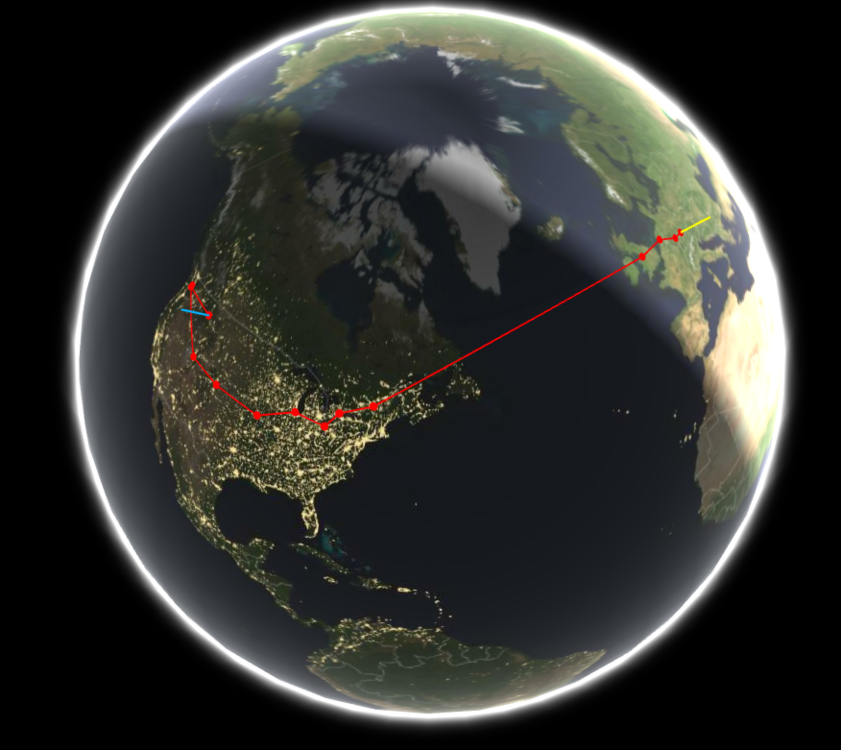
Routers
A router is a device that handles forwarding packets to their next destination
TCP/IP packets hop from network to network to get to a particular destination determined by routing tables
Within an organisation may have routers and switches handling multiple subnets
https://geotraceroute.com

Slide 10

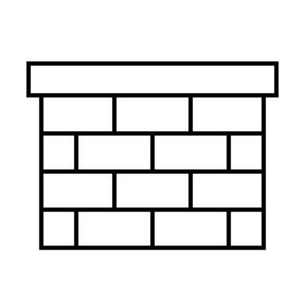

Firewalls
Firewalls are network devices that apply a set of rules to incoming and outgoing network traffic.
The rules are based on IP addresses and ports
Firewalls can be used to create secure zones that partition communications from different sets of users
For example, Staff and students can access the intranet website
Outsiders can access the main UWA website
We can control access using routers and firewalls that blocks access to internal sites
intranet.uwa.edu.au
www.uwa.edu.au

Slide 11
HTTP
HTTP Hypertext Transfer Protocol is the communication protocol used to access resources like web pages, images and media files from a web server
It operates at the Application layer of TCP/IP
It operates using URLs (Uniform Resource Locators) to refer to specific resources that it wants to web server to take action on – like fetching it for display in a browser
HTTP is unencrypted and so is not confidential

Slide 12
HTTPS/TLS
HTTPS is a secure version of HTTP (hence the S) that initially used SSL (Secure Socket Layer) although this became TLS for Transport Layer Security
HTTPS is still referred to as SSL
Current version of TLS is 1.3 although 1.2 is still prevalent
TLS makes use of certificates that have the verified identity of the server and the server’s public key
The certificate is verified by a trusted certificate authority. Browsers maintain a list of these that gets updated from time to time

Slide 13
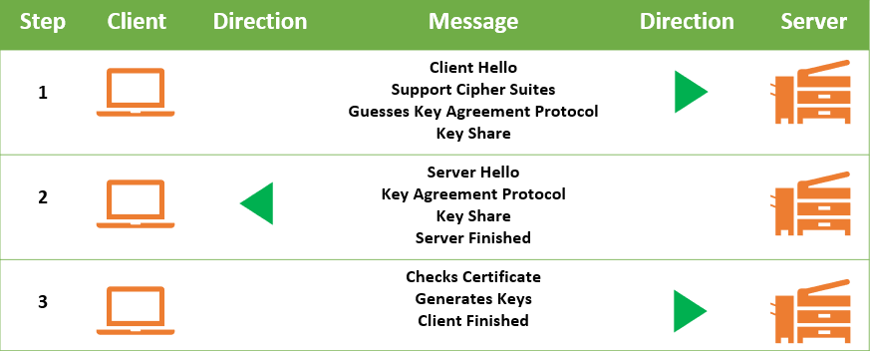
TLS 1.3
TLS establishes a connection by exchanging messages to:
Agree the cipher that will be used
Which key exchange protocol to use
Create and share keys
Check server and client identity through certificates
https://cheapsslsecurity.com/blog/tls-1-3-everything-you-need-to-know/

Slide 14
VPN
Virtual Private Network (VPN) software allows a computer on one network to create a direct connection to another network over a secure link
Effectively you get an IP address on the network you have connected to
VPNs can run over a number of different protocols: e.g. IPSec, OpenVPN, IKEv2 and WireGuard
Communications are encrypted and so not visible to anyone inspecting traffic - even to the ISP you are using
Connecting to a network in a different country will make it appear that the computer is in that country
Location can leak from other sources such as the browser
VPNs provide security through encrypted communication and privacy through the VPN provider not keeping logs
VPNs do not provide anonymity

Slide 15
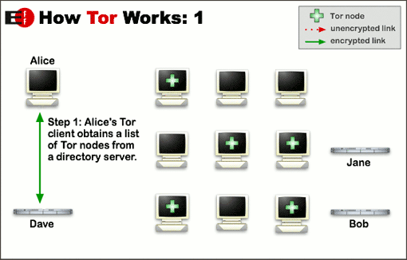
Tor and The Dark Web
Tor (The onion routing project) is software that provides IP anonymity by bouncing encrypted packets over a set of Tor servers called relays or nodes.
The Tor client obtains a set of nodes from a directory server

Slide 16
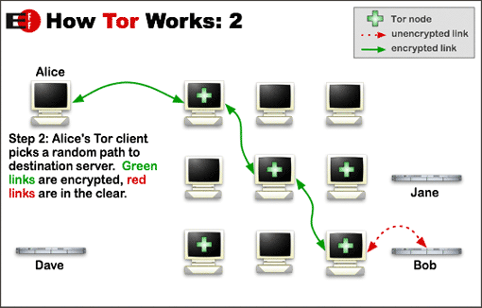
How Tor Works 2
The Tor client decides on a random path through the nodes and encrypts the message with each nodes key
This is the analogy with the onion layers

Slide 17
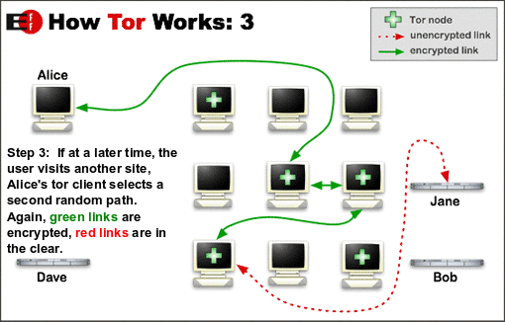
How Tor Works 3
Each subsequent site chooses a new path
The server only has a return address of a the exit node

Slide 18
Tor Onion (Hidden) Services
Tor uses an address called an onion address to connect to services offered on the Tor network
These addresses are like URLs
The Dark Web is essentially the collection of onion services that are not indexed directly by search engines on the “regular” web
Because of the anonymity provided by Tor and the semi-hidden nature of onion services, many illegal activities have flourished with Dark Markets selling illegal products that are paid for using cryptocurrencies
The anonymity provided by Tor is also of more positive use by activists and those simply wanting to browse the web anonymously

